Slide 1

INSIGHTS ON HEALTH CARE ANALYSI PROJECT
Vijay Krishna M

Slide 2
What is HEALTH CARE Analytics?
Healthcare analytics refers to the use of data analysis techniques and tools to gain insights from healthcare-related data. It involves collecting, processing, and analyzing data from various sources (e.g., patient records, clinical data, financial data) to improve healthcare outcomes, enhance operational efficiency, and reduce costs.

Slide 3
Key Areas of Healthcare Analytics:
Descriptive Analytics:
Focuses on understanding past events by analyzing historical data. This includes metrics like patient demographics, treatment success rates, and hospital performance.
Predictive Analytics:
Uses statistical models and machine learning techniques to predict future events. For example, predicting patient outcomes, readmission rates, or identifying patients at risk for certain conditions.
Prescriptive Analytics:
Recommends actions based on data analysis to optimize healthcare decisions. For instance, suggesting the best treatment plans or resource allocation to improve patient care.
Operational Analytics:
Aims to optimize hospital operations, such as improving patient flow, staffing, and supply chain management.
Clinical Analytics:
Focuses on patient-related data to improve clinical care, treatment protocols, and health outcomes.
Financial Analytics:
Involves analyzing financial data to reduce costs, detect fraud, and improve billing and reimbursement processes.

Slide 4
Benefits of HEALTH CARE Analytics
Improved Patient Care: By identifying trends and outcomes, healthcare providers can offer better treatment and care plans.
Cost Reduction: Helps in managing operational costs, reducing waste, and identifying inefficiencies.
Better Decision-Making: Data-driven decisions help healthcare organizations improve strategies and policies.
Enhanced Research: Identifies patterns that can contribute to medical research and drug development.
Healthcare analytics plays a crucial role in shaping a data-driven, efficient, and patient-centered healthcare system.

Slide 5


Tools used for Banking Analytics Project
Advanced Excel
MySQL

Slide 6
Steps followed in Analysis Process
Understanding the raw data
Cleaning of Data
Developing Relationship between the data
Understanding the main KPIs and also adding some additional KPIs
Creating single visuals for each KPIs
Merging all the single visuals in single window and preparing a working dashboard for understanding the nature, trend in different banking sectors (e.g. : Loan, Mortgage, Credit Dates, Loan as per states, etc)

Slide 7
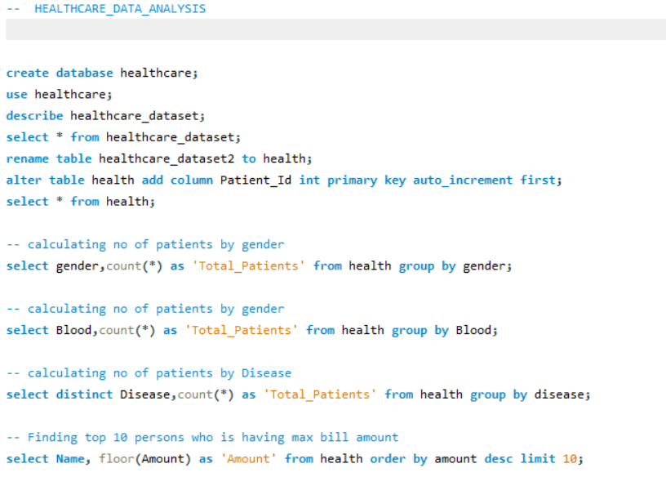
Queries in MySQL

Slide 8
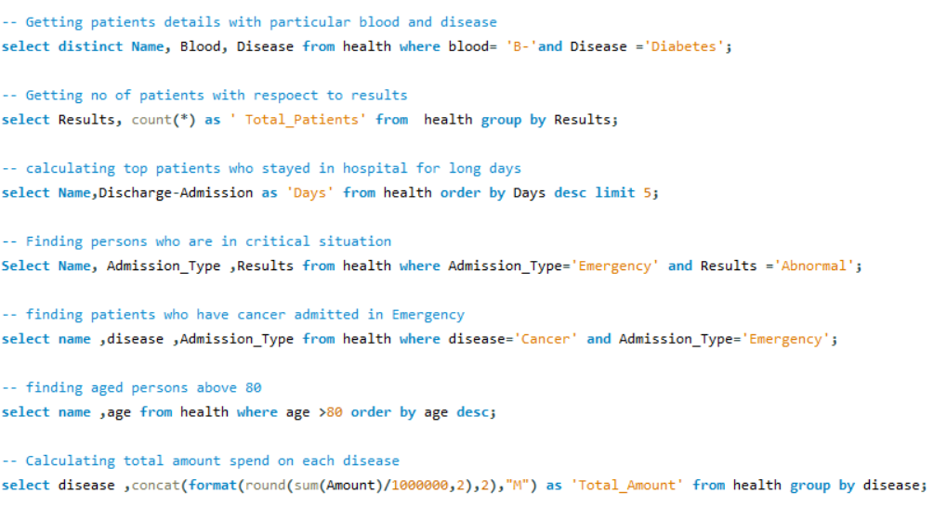
Queries in MySQL

Slide 9
Take away from the Project
Here are the key takeaways from a healthcare analysis project in short:
Data Cleaning: Ensuring accurate and clean data is essential for reliable analysis.
SQL Skills: SQL is powerful for querying large healthcare datasets.
Data Visualization: Dashboards help communicate insights effectively to non-technical users.
Predictive Insights: Predictive models can help identify at-risk patients and improve care.
Data Integration: Combining data from different sources can be challenging but crucial.
Privacy & Security: Adhering to data privacy laws (e.g., HIPAA) is critical in healthcare.
Impactful Decisions: Data-driven insights lead to better patient care and operational efficiency.
These are the fundamental lessons learned throughout the project.

Slide 10
THANKYOU!!

